Slide 1
SCC204 Software Design
Use Cases-Principle
Dr. Zhang Jinyu
(zjy@bjtu.edu.ucn)

Slide 2
Today’s focus
You’ve learned:
Requirements
Requirements engineering
In this lecture, you will
Understand the role of Use Cases in requirements discovery

Slide 3
Requirements discovery
我们如何发现需求?
从我们对问题的理解来看
How can we discover requirements?
From our understanding of the problem
So we can specify the solution
There are many ways to do this
But the obvious one, asking users what they want, doesn’t work very well
The analyst needs to work with stakeholders, understand their needs, mediate between them when they disagree, and propose solutions
Use case analysis is one way to do this

Slide 4
Use Cases
A use case is a behavioural model of a system
It describes how a system responds to stimuli from “outside” of the system
A use case model consists of:
A use case diagram
A set of use case descriptions
用例是系统的行为模型。
它描述了一个系统如何回应来自系统“外部”的刺激
两种use case
diagram
description

Slide 5
A Use Case diagram
An Actor
- a user or or another system that interacts with our system
第一个单词一定是动词
Coursework submission
A Use Case
- a verb-noun phrase
Submit coursework
Tutor
Student
老师
Issue work
System
Boundary
Register student
System administrator
Archive work
Course administrator
作业存档

Slide 6
Use case descriptions
用户
The diagrams serve as a high-level reference
What use cases are there?
Which actors interact with each use case?
The use cases need to be developed to find out:
What happens and in what order.
What the actors require.
Use case descriptions are developed as scenarios

Slide 7
Submit coursework (1)
Precondition:
1. Student has been issued with assignment
2. Student has completed assignment
Flow of events:
….
Postcondition:
1. Student receives mark
2. Student’s mark is recorded
前提条件
如何提交作业
交完作业后

Slide 8
Submit coursework (2)
Flow of events:
1. Student submits coursework.
2. Course administrator records submission.
3. Course administrator passes submission to tutor.
4. Tutor marks submission.
5. Tutor returns marked submission.
6. Course administrator records mark.
7. Course administrator returns marked submission.
But … this is only one possible sequence of events for this use case:
happy day

Slide 9
What about late submissions?
We could introduce control structures into our description
1. Student submits coursework.
2. Course administrator records submission.
3. If deadline expired
3.1. Course administrator marks submission ‘late’ with date
4. Course administrator passes submission to tutor.
5. ….
This approach is too procedural:
Essential properties get obscured with detail.
It’s hard to know when to stop - we tend to write algorithmic solutions rather than capturing what is the essential behaviour.
基本属性被细节所掩盖。

Slide 10
Instead, use scenarios
Describe:
A primary (‘happy day’) scenario:
Captures what we expect to be the normal behaviour.
Some secondary scenarios:
That reveal useful information: e.g. exceptions
Hence, a use case is just a collection of revealing scenarios.
You develop the (user) scenarios with the users.
正常场景
用例只是一组显示场景的集合

Slide 11
Submit coursework (3)
Flow of events:
Primary scenario
1. Student submits coursework.
2. Course administrator records submission.
3. Course administrator passes submission to tutor.
4. …
Secondary scenarios
Late submission

Slide 12
Submit coursework (4)
Late submission
Flow of events:
1. Coursework deadline expires
2. Student submits coursework.
3. Course administrator records submission.
4. Course administrator marks submission ‘late’ with date
5. Course administrator passes submission to tutor.
6. ...

Slide 13
Scenarios and Requirements
Sometimes the use cases are used as the specification
Normally, use cases are used to derive requirements of the kind we saw earlier
Because of what they reveal about actions by the user and the system, and about sequencing, events are the primary sources of the requirements.
->正规的文档
推导

Slide 14
Submit coursework (5)
CS1.1 A student shall be able to submit a coursework assignment to the system at any time once the tutor has issued the assignment.
CS1.2 On receipt of a coursework submission, the system shall record the assignment, the name of the submitting student and the time and date.
CS1.3 On expiry of the coursework deadline the system shall issue a report to the tutor and course administrator listing the names, and submissions dates and times of each student registered on the module.
CS1.4 On receipt of a coursework submission after expiry of the coursework deadline, the system shall alert the tutor and coursework administrator, and amend the record of the submitting student in the submission report to record the submission time and date and shall mark the record ‘LATE’.
CS1.5 At any time following issuing of the assignment, the tutor shall be able to access the coursework submissions received by the system.
CS1.6 …….
Note: each requirement is uniquely identified. This is needed to manage them.

Slide 15
Some things to note ….
My submit coursework use case modeled the as-is situation
Normally, I would then derive a set of use cases to model the system-to-be, and derive requirements from these
I have deliberately tried to avoid making premature design decisions
Express the requirements in a technology-neutral way
Let the software designer find the right way to implement your requirements (not necessarily in software)
因为，所以

Slide 16
Submit coursework (6)
CS1.1 A student shall be able to submit a coursework assignment to the system at any time once the tutor has issued the assignment.
CS1.2 On receipt of a coursework submission, the system shall record the assignment, the name of the submitting student and the time and date.
CS1.3 On expiry of the coursework deadline the system shall issue a report to the tutor and course administrator listing the names, and submissions dates and times of each student registered on the module.
CS1.4 On receipt of a coursework submission after expiry of the coursework deadline, the system shall alert the tutor and coursework administrator, and amend the record of the submitting student in the submission report to record the submission time and date and shall mark the record ‘LATE’.
CS1.5 At any time following issuing of the assignment, the tutor shall be able to access the coursework submissions received by the system.
CS1.6 ……
How?
Email?
Write-enabled folder?
FTP?
How?
Email?
Post?

Slide 17
Using use case requirements discovery
Use cases are best developed by the users (actors) in a workshop run by the analyst
The requirements should be stored in a requirements management database
The requirements should be validated by the users
Once validated, they can be issued in a requirements specification document which will form the basis of subsequent development
座谈会
should:可做可不做

Slide 18
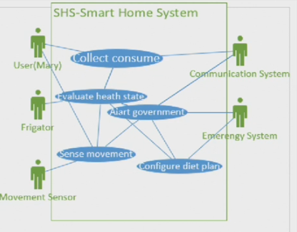
A Use Case diagram for SHS?
Smart Home System
冰箱

Slide 19
In the next lecture…
We’re going to see
More use case examples
Textual description of use cases

Slide 20
?
Question

Slide 21
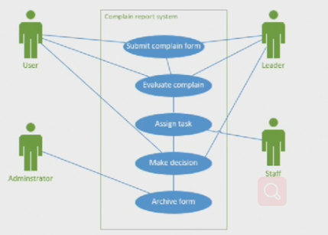
评估，看是否合理
处理
反馈给
管理员存档

